Slide 1
Intro to Raspberry Pi
A Southwest Florida Hackerspace
Workshop
Presented by:
Russell Benzing & Eric Schiffli

Slide 2
WHO WE ARE
Non-Profit Florida Organization
We are looking for a Fort Myers industrial space to build our local makerspace.
MISSION STATEMENT:
Our mission is to create a space where people can network, learn and get creative using all types of technology with access to tools, people and resources.

Slide 3
WHY ARE YOU HERE?
YOU:
Enjoy “tinkering” with technology.
Do not mind writing a little bit of code.
Have experience in Linux, Robots, Sensors, etc.
Recently announced you have an addiction to raspberry pie.

Slide 4
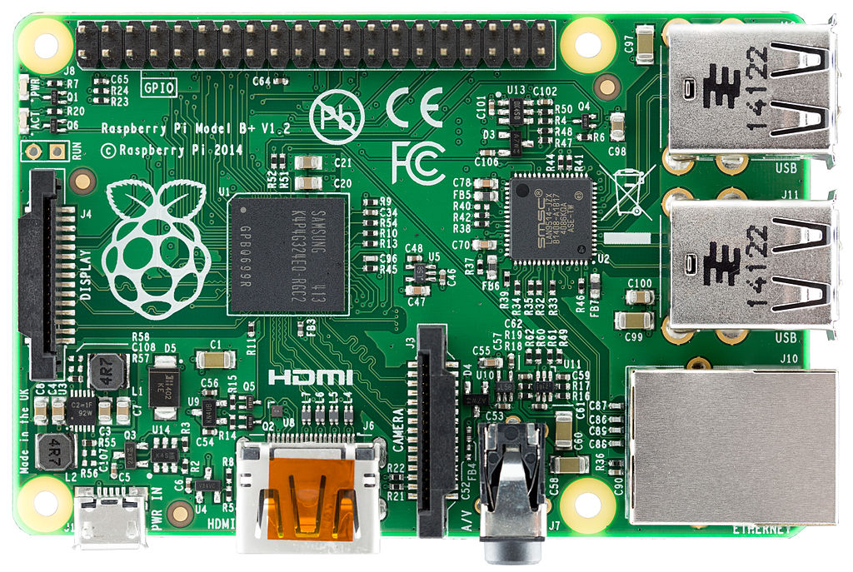
WHAT WILL I LEARN?
What a Raspberry Pi is and does.
How to setup the Pi for the first time.
Basic Commands and Familiarization.
Setup your first sensor and LED.
Pi Resources & Tutorials

Slide 5
WHAT IS A RASPBERRY PI?
A low cost, credit-card sized computer
GPIO 40 Pin
4 USB Ports
LCD Display
RJ45 Ethernet
Power
Pi camera
3.5mm Audio
HDMI

Slide 6
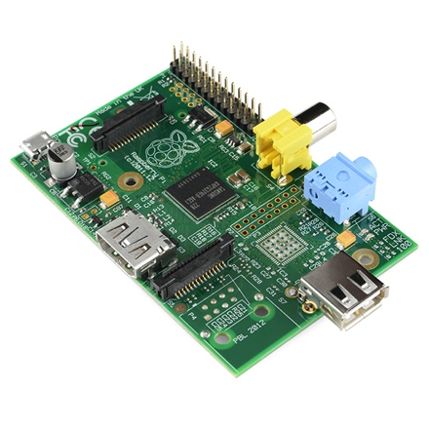
THE HISTORY OF PI
Created by Eben Upton.
Early concepts started in 2006.
Officially launched in early 2012.
Inspired by Acorn’s BBC Micro from 1981.
Idea came about to inspire and educate children in computers.

Slide 7
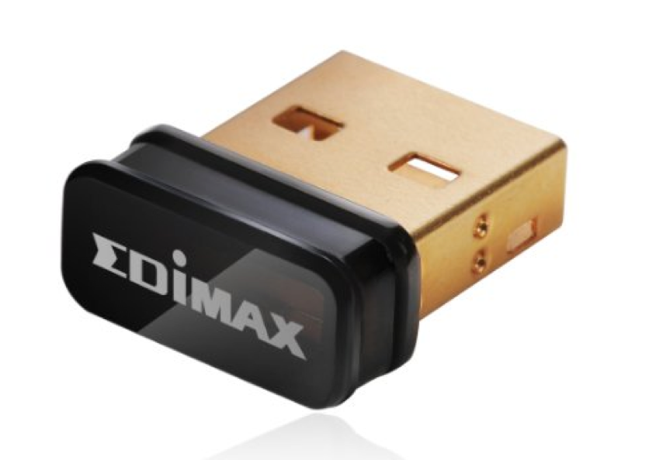
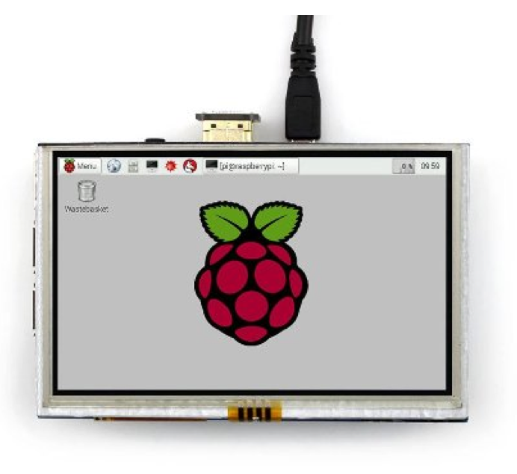
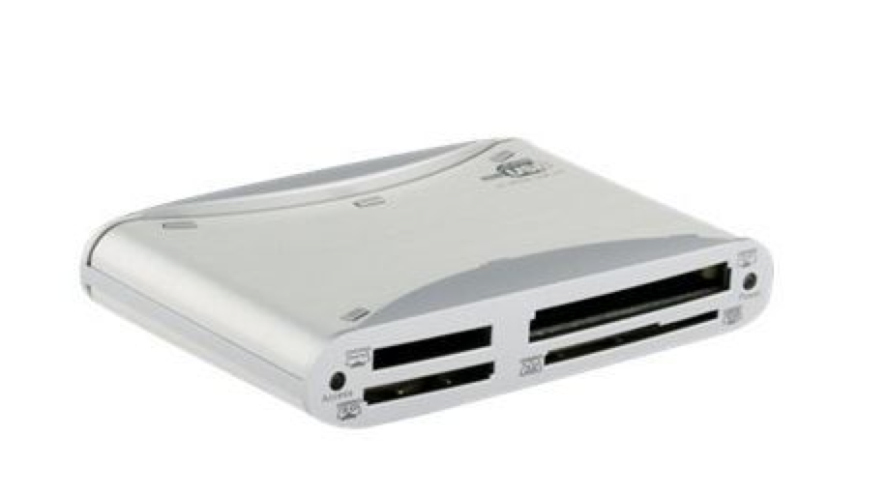
GETTING STARTED -
REQUIREMENTS
Raspberry Pi B+ or newer.
USB WIFI adapter.
Keyboard and/or mouse.
Laptop or HDMI display monitor.
SD Card (8 GB+ recommended).
SD Card Reader.

Slide 8
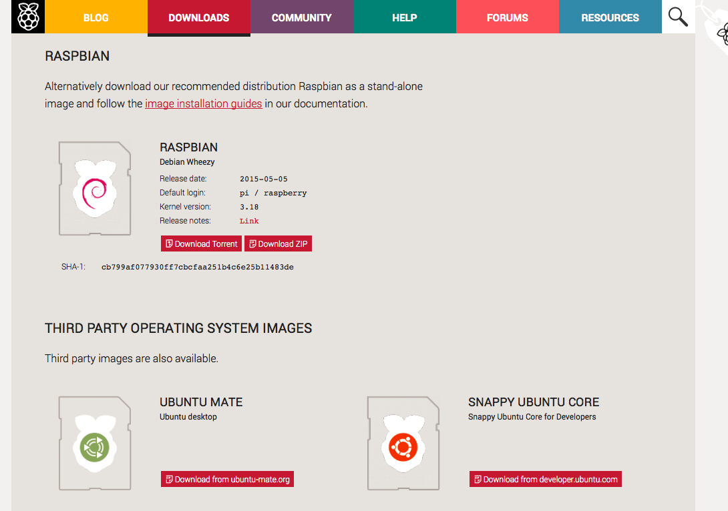
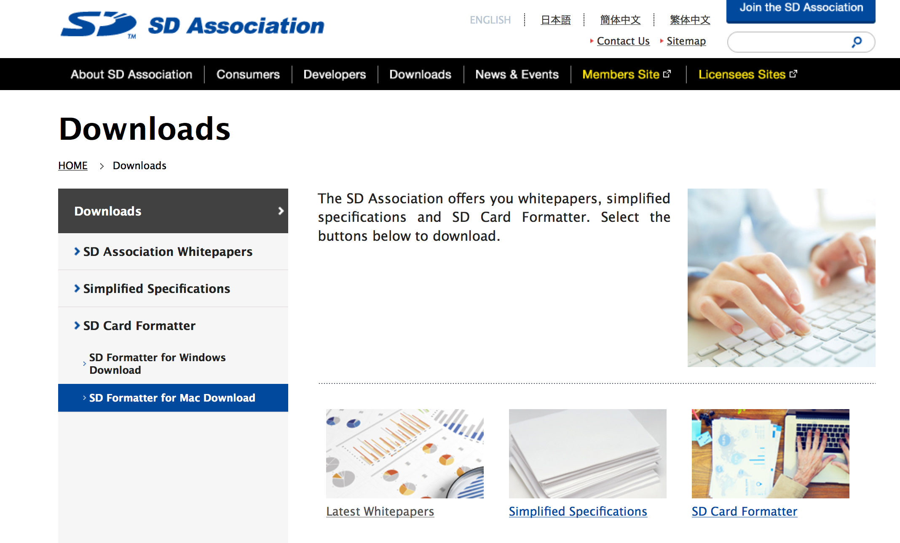
GETTING STARTED -
DOWNLOAD
Download your Operating System:
Visit www.raspberrypi.org Click on downloads.
2. Download an SD Card Formatter:
Visit www.sdcard.org
Click on downloads

Slide 9
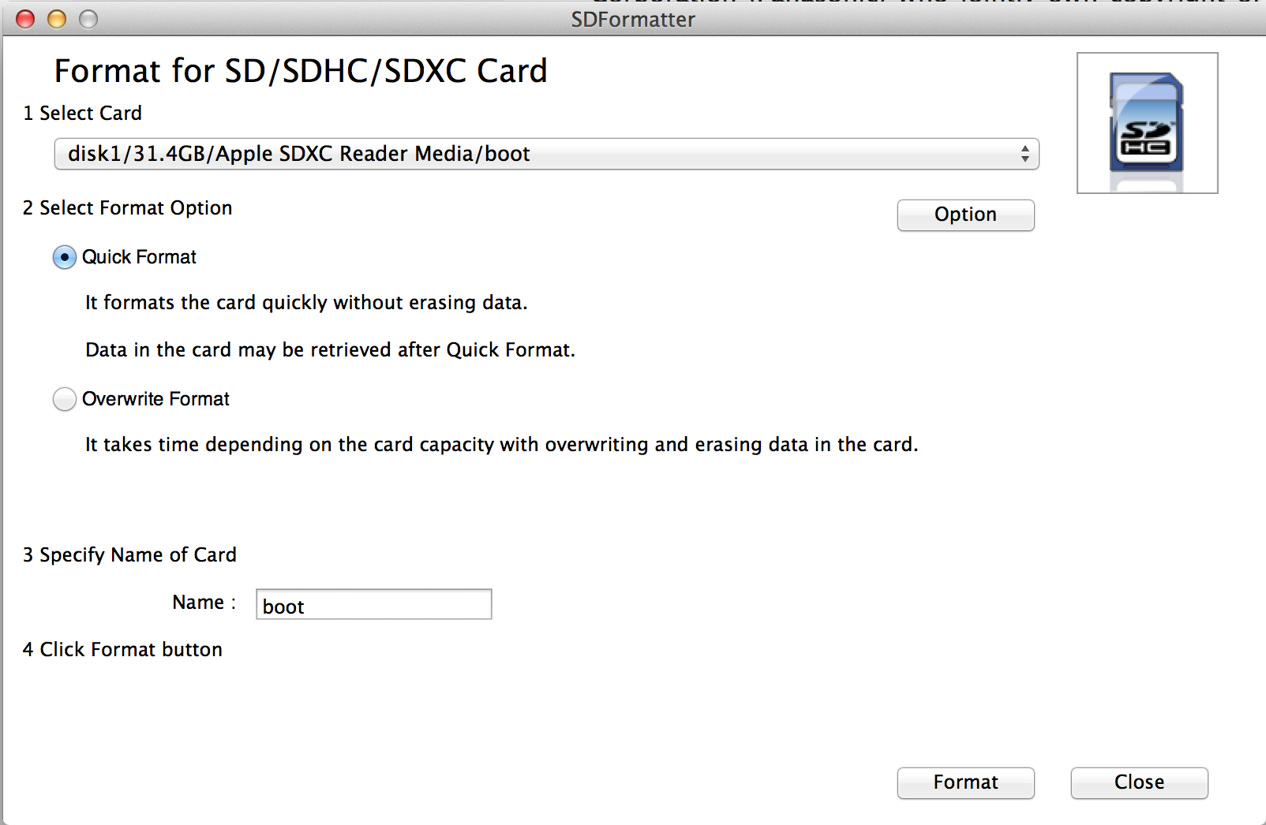
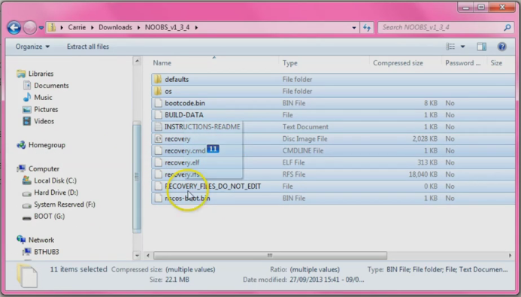
GETTING STARTED -
EXTRACT & COPY
Format your SD Card using the SD Formatter – More instructions found online.
Extract OS to a folder and drag and drop onto your newly formatted SD Card.

Slide 10
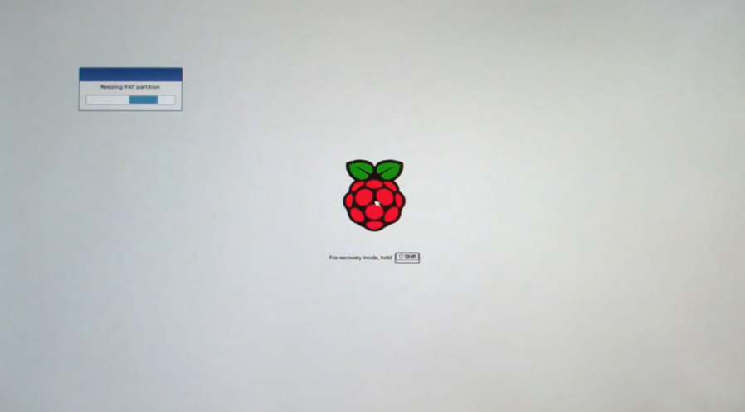
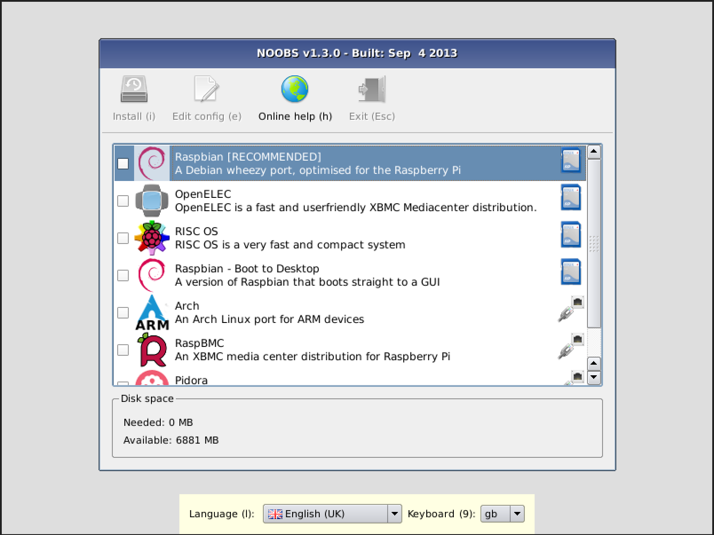
GETTING STARTED -
FIRST BOOT
If you installed NOOBS, then you will be presented with a select an OS screen.
Check the box for Raspbian, at this point you can also select your language settings at the bottom of the screen , click Install. This can take up to 20 minutes on the older Pi variations.

Slide 11
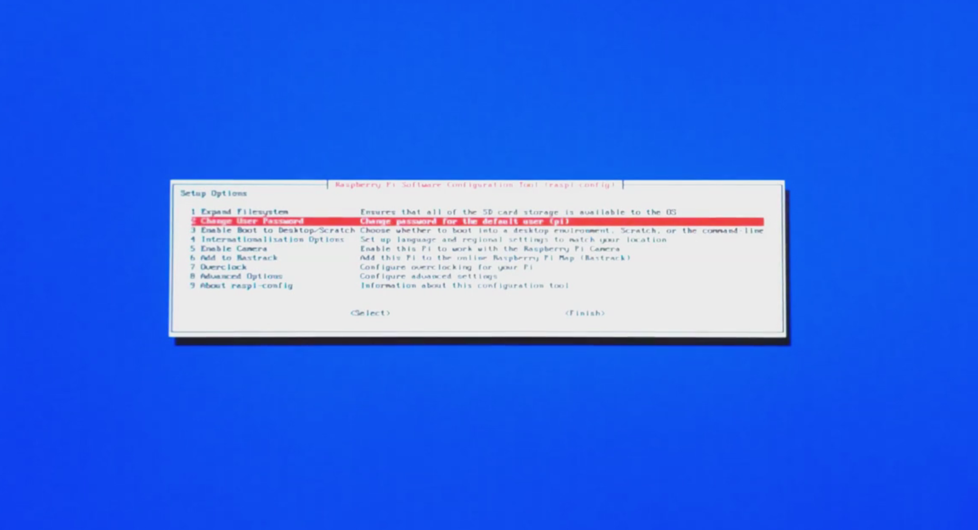
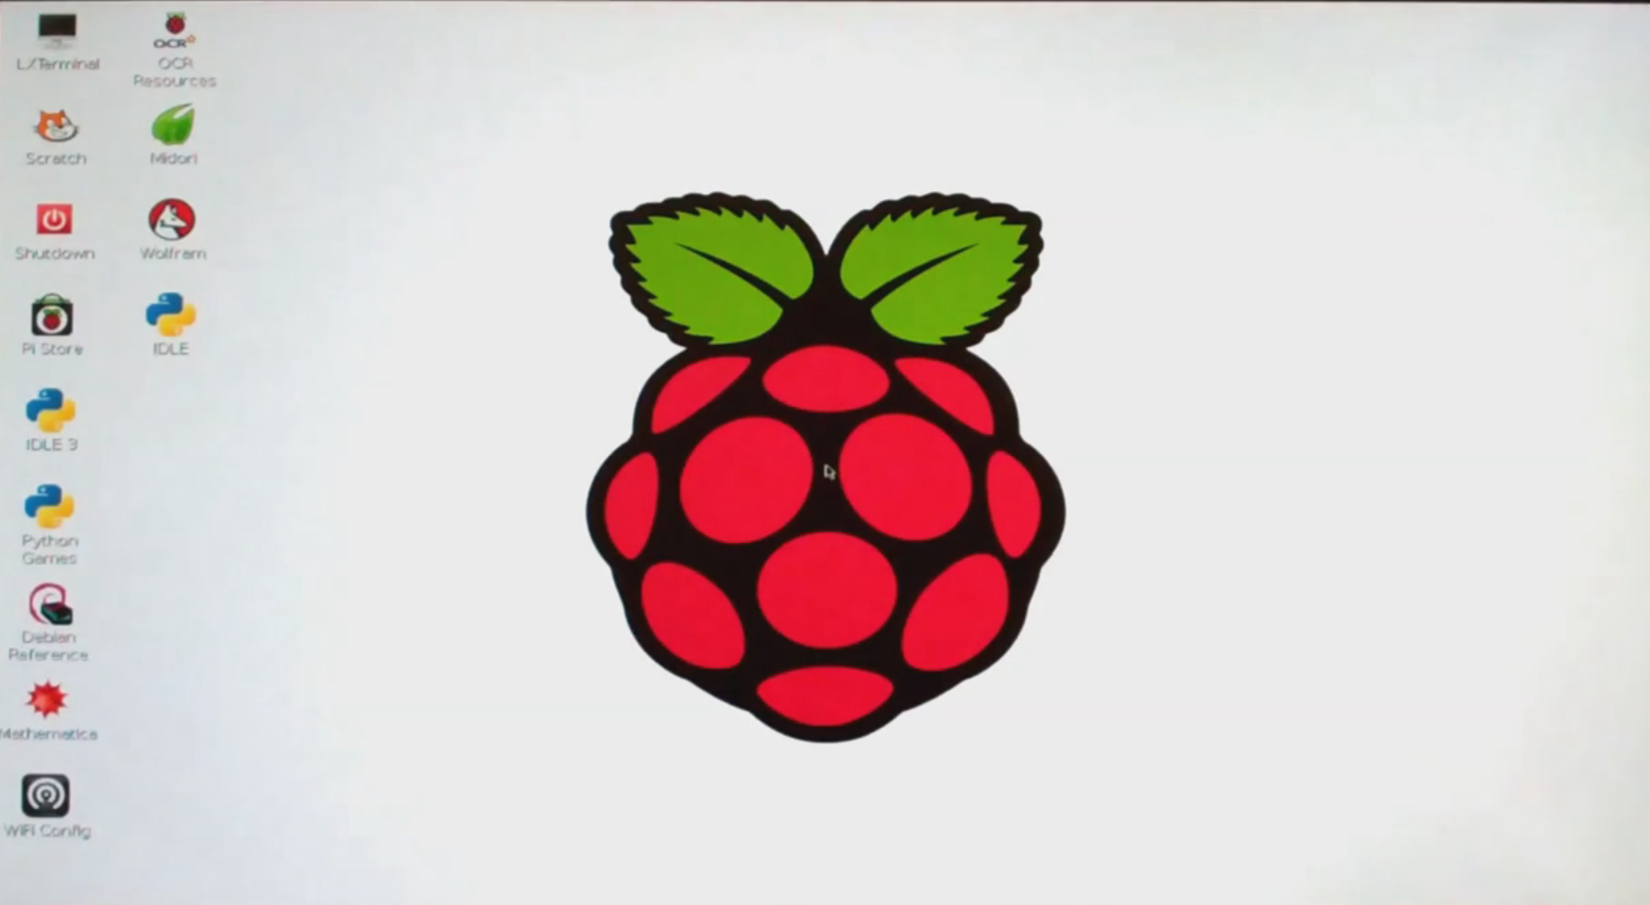
GETTING STARTED -
CONFIGURATION
When booting up for the first time you will get the blue “raspi-config” screen. Here you can configure your Pi with language and keyboard settings for your desired region of the world. Use tab and arrow keys to browse.
Once configured to your liking go to <Finish> and hit enter. This will take you to the command prompt where you will need to type in “startx” to start up the GUI (Graphical User Interface)

Slide 12
BASIC PI COMMAND LINE - 1
Useful commands to run from a terminal or command line.
raspi-config
Change your pi configuration settings. startx
Start the GUI (Graphical User Interface) ifconfig Get the details of your Ethernet or wireless network adapter. rpi-update Updates your Raspberry Pi firmware. lsusb Shows a list of usb devices. apt-get update & apt-get upgrade Update or upgrade your pi software
ssh
Connect your pi to other computers. sudo
Run commands as super user. shutdown This will shutdown your pi. nano This is your text editor for changing or adding files. Save, edit, create. cat Read out files at the command line. passwd Change your user password.

Slide 13
BASIC PI COMMAND LINE - 2
Useful commands to run from a terminal or command line.
ls
List out the current directory files. cd
Go to directory or folder. find Searches whole system for files or directories. clear Clears the terminal screen. mv Move files or folders. rm & rmdir Remove files and remove directories.
touch
Create a blank file. mkdir
Create a directory. ping Test connectivity between two devices. df -h Shows disk space. iwconfig Wireless configuration tool. cp Copy files and folders.

Slide 14
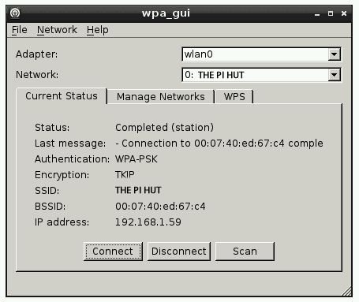
ADDING OTHER FEATURES
WIFI Configuration (GUI)
1. Launch “Wifi Config” from the desktop. 2. Click “Scan” 3. Double click your desired network. 4. In “PSK” field enter your wifi password. 5. When done click “Add” and it will connect.
Setup Bluetooth (GUI)
Plugin your Bluetooth dongle via USB and open terminal window.
Type in “lsusb” to list all USB devices and verify your device is being recognized.
Install the required software by typing:
You can manage bluetooth going to: Menu -> Preferences -> Bluetooth
sudo apt-get install bluetooth bluez-utils blueman bluez python-gobject python-gobject-2

Slide 15
CONGRATULATIONS!
Take this time to celebrate and enjoy some Pi before we go to the next level. Your on your way to being a Pi guru.
What’s Next?

